Slide 1



Background Processing
Hangfire v Microsoft Logic Apps
Notes:
Verbatim
Simple Topic
Logo

Slide 2


Joel Viney
Software developer for 20 years
Developing Azure on and off 4 years
Team Lead at QuillGroup
My work involves lots of Integration, Batch Processing.
https://github.com/JoelViney
Notes:
Software Developer 20 years
Azure 4 years
Teamlead Quillgroup
QuillGroup Accounting, Financial Planning and Superannuation services in Southport and Brisbane
Integration: AbnLookup, ASIC company search, Jira, Bank Codes, Box (google drives awkward step brother), Class, DocuSign, Email Service, IntegraPay, Salesforce, SuperFundLookup, Xero and Xero Practice Manager.
This might not be super-relevant right now, but you get the point.
Github Link: This is my Github profile link. It includes this presentation and not enough other stuff to impress employers…
Skipped Wedding Picture: I skipped the wedding profile photo this time… I really hate that photo but at least you guys are not going to bag me out for putting up a wedding photo.

Slide 3

Background Processing
Azure Scheduler
“Azure Scheduler will retire on September 30, 2019”
Azure Logic Apps
“Azure Logic Apps is a cloud service that helps you automate and orchestrate tasks, business processes, and workflows when you need to integrate apps, data, systems, and services across enterprises or organizations”
Hangfire
“An easy way to perform background processing in .NET and .NET Core applications. No Windows Service or separate process required. Backed by persistent storage. Open and free for commercial use.”
Other Options? E.g. Quartz?
Notes:
Background processing, background jobs, scheduled tasks, cron jobs
Newsflash, Azure Scheduler is dead. 30th September.
So where does that leave us?
Azure Logic Apps
“Azure Logic Apps is a cloud service that helps you automate and orchestrate tasks, business processes, and workflows when you need to integrate apps, data, systems, and services across enterprises or organizations”. That sounds fucking amazing...
Hangfire
“An easy way to perform background processing in .NET and .NET Core applications. No Windows Service or separate process required. Backed by persistent storage. Open and free for commercial use.”… That sounds okay as well.
* Other options? Quartz java port for C#.. No Time

Slide 4
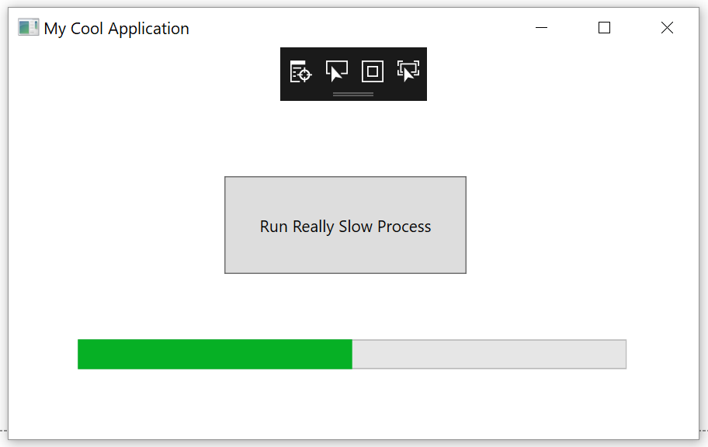
My History with Background Processing
Button -> Manually Triggering Job
Windows Scheduler -> Exe
Windows Service
Azure Scheduler -> Azure Job
Azure Scheduler -> Http Endpoint
Azure Scheduler -> ServiceBus -> Azure Job
Hangfire
Notes:
Every Developer: Scheduling background jobs is something that every developer will come across at some stage.
I’m going to go through each one and give my opinion, your results may vary. In the past I've used or worked on:
Button -> Manually Triggered Job
Own Business: I have actually done this, in my defense it was for my own business and I never really got around to automating it.
+ Easy. Add Progress Bar
- Annoying for the end user
Windows Scheduler -> Exe
- 2 x Installation - Issues keeping your production / job code synchronized.
- I just felt dirty
Windows Service
- Installing is a pain
- Double the Installation - Issues keeping your production / job code synchronized.
- IMHO Its just a bit of a pain in the arse.
Azure Scheduler -> Azure Jobs / Function
+ Easy Installation, there is a bit of dicking around with logging as its running in a separate process.
- Double the Installation - Issues keeping your production / job code synchronized.
Azure Scheduler -> Triggering an http endpoint
+ Easy Installation
- Session timeout issues?
- Security issues
- Uses websites resources
- I felt dirty again
Azure Scheduler -> Azure Service Bus
- Complex, so god damn complex
- All the limitations of Azure Jobs
* Hangfire
+ Easy to install
- Uses websites resources

Slide 5

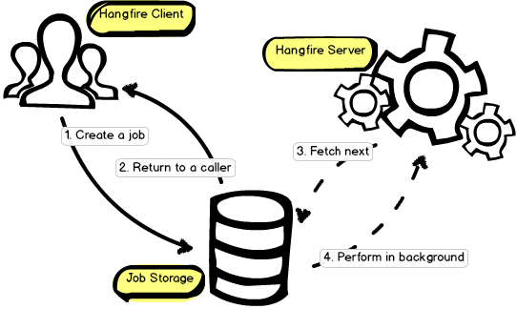
https://www.hangfire.io/
What is it? Simple scheduling
Uses your websites / apps resources
Open Source -> LGPL 3.0
.Net 4.5 and .Net core
Persistence: InMemory, SQL Server
or Redis (paid only)
Will scale out
Automatic Retry
IOC
Notes:
AM I TALKING TO FAST?
Hangfire, logo!
What is Hangfire? Simple, Scheduler and Dashboard…
Websites Resources. You program it in your application, and it uses your websites / applications resources.
- Performance… to this is it may impact your websites performance with too many heavy jobs.
+ Add 2nd Website? If that becomes a problem you can created a dedicated website / app to process the jobs.
Open Source -> Free Commercial Applications -> you can use it for free LGPL 3.0. Use it for free, including it with your commercial applications.
Supports 4.5 and core.
Storage: InMemory, Sql Server, Sql Server Express, Azure Sql Database and Redis (paid version only)
Scale Out. * Instances. It will scale out if you decide to run multiple instances of your website
Built in retry for jobs… Yay? I suppose it stops me writing some defensive code… Like that’s not what I do all day?
IOC It uses your built in IOC so no need to get complex. Autofac + .net core

Slide 6
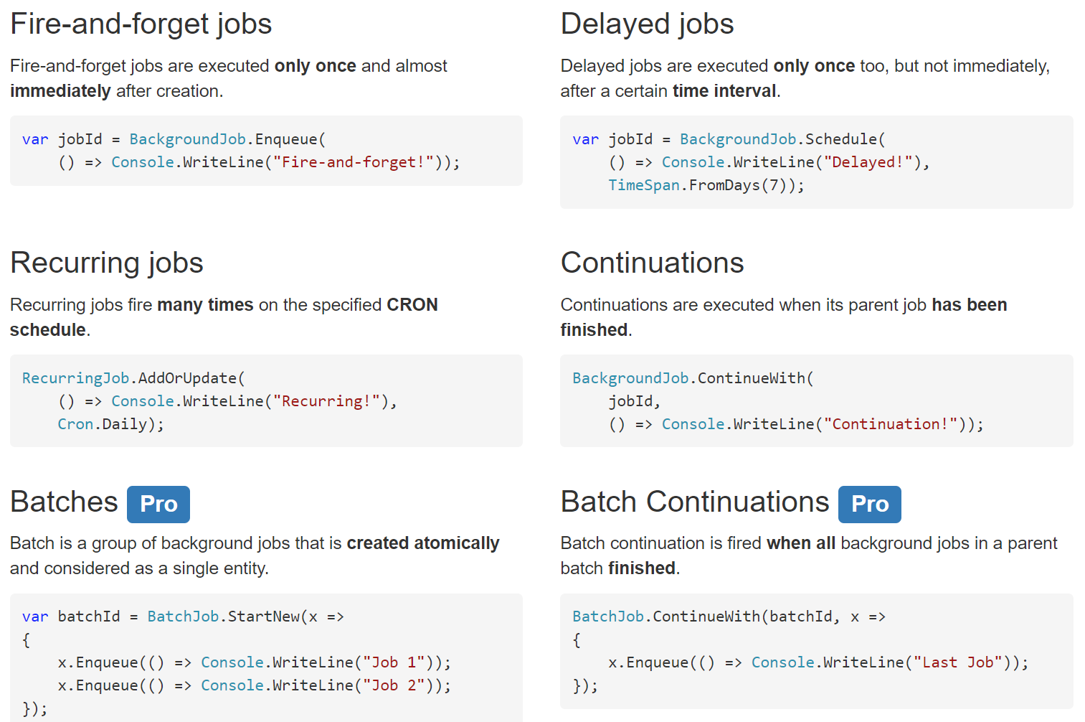
Hangfire – Job Types
Notes:
This is actually pretty cool.
Fire and forget Jobs - > Just Do It.
Delayed jobs… 24 Hour Cart Reminder.
That could be cool, process new customers after hours, 24 hour cart reminders? Maybe give them a 10% discount code? Work out timezones so your not sending it in the middle of the night.
Recurring jobs. Meat. -> The meat in a schedulers sandwich.
Continuations -> Because I want to put our complex business logic in a scheduler? I’m sure there are use cases for that, I don’t know.
Batch… Because I want to put our complex business logic in a scheduler. // I can’t afford that.

Slide 7
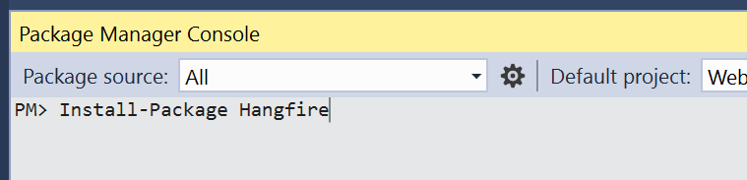
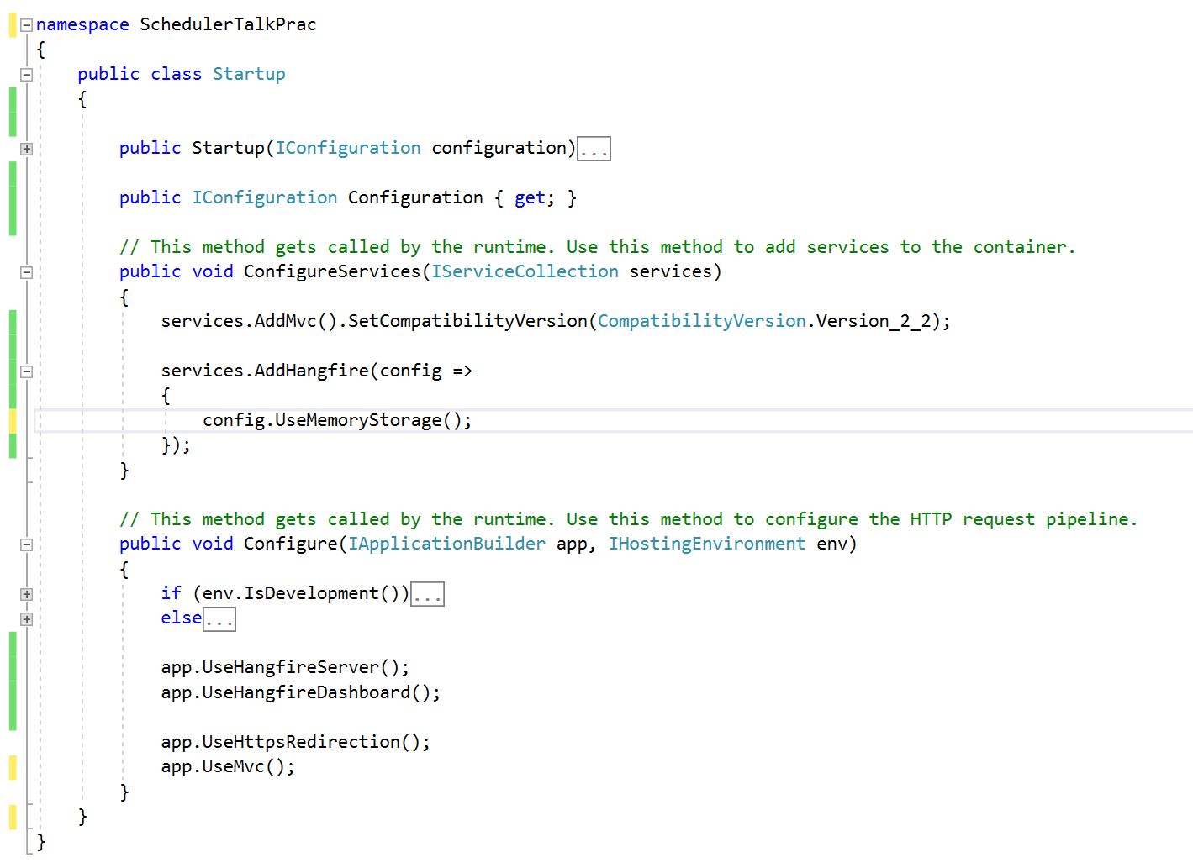
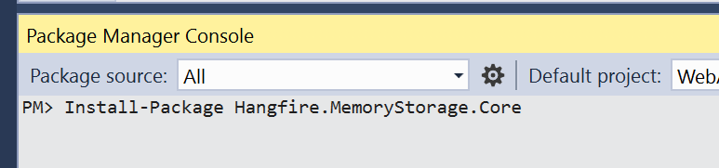

Hangfire Installation
Notes:
Install-Package Hangfire
Install-Package Hangfire.MemoryStorage.Core
Install-Package Hangfire.Console
ConfigureServices:
services.AddHangfire(config =>
{
config.UseMemoryStorage();
config.UseConsole();
});
Configure:
app.UseHangfireDashboard();
app.UseHangfireServer();
RecurringJob.AddOrUpdate<CreateWidgetJob>("Create Widgets Job", x => x.Execute(null), Cron.Minutely());

Slide 8
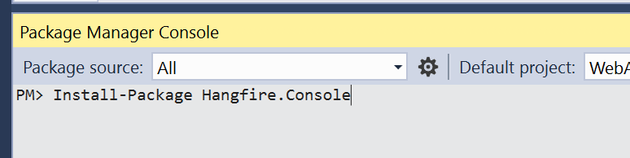
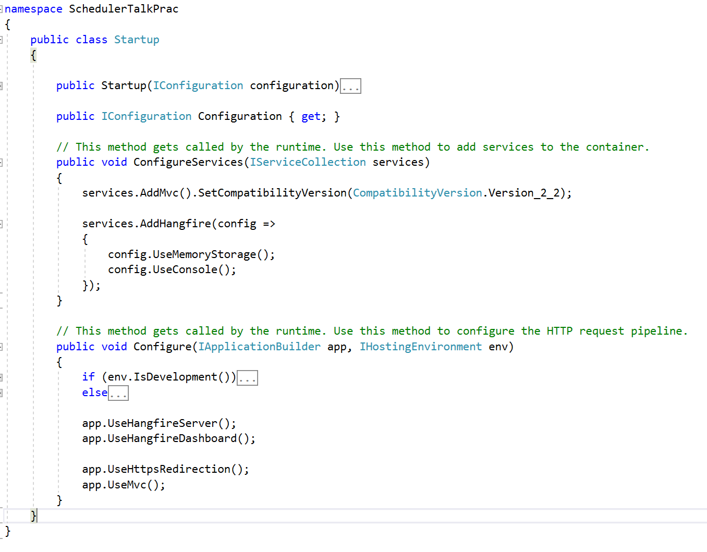
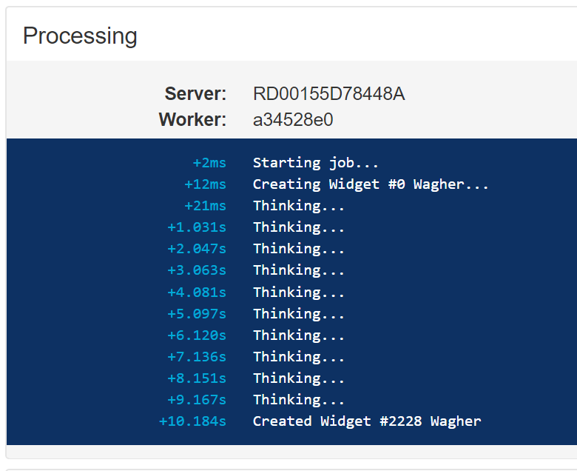


Hangfire.Console
Notes:
Hangfire.Console
* Install-Package Hangfire.Console
* ConfigureService:
Config.UseConsole();

Slide 9
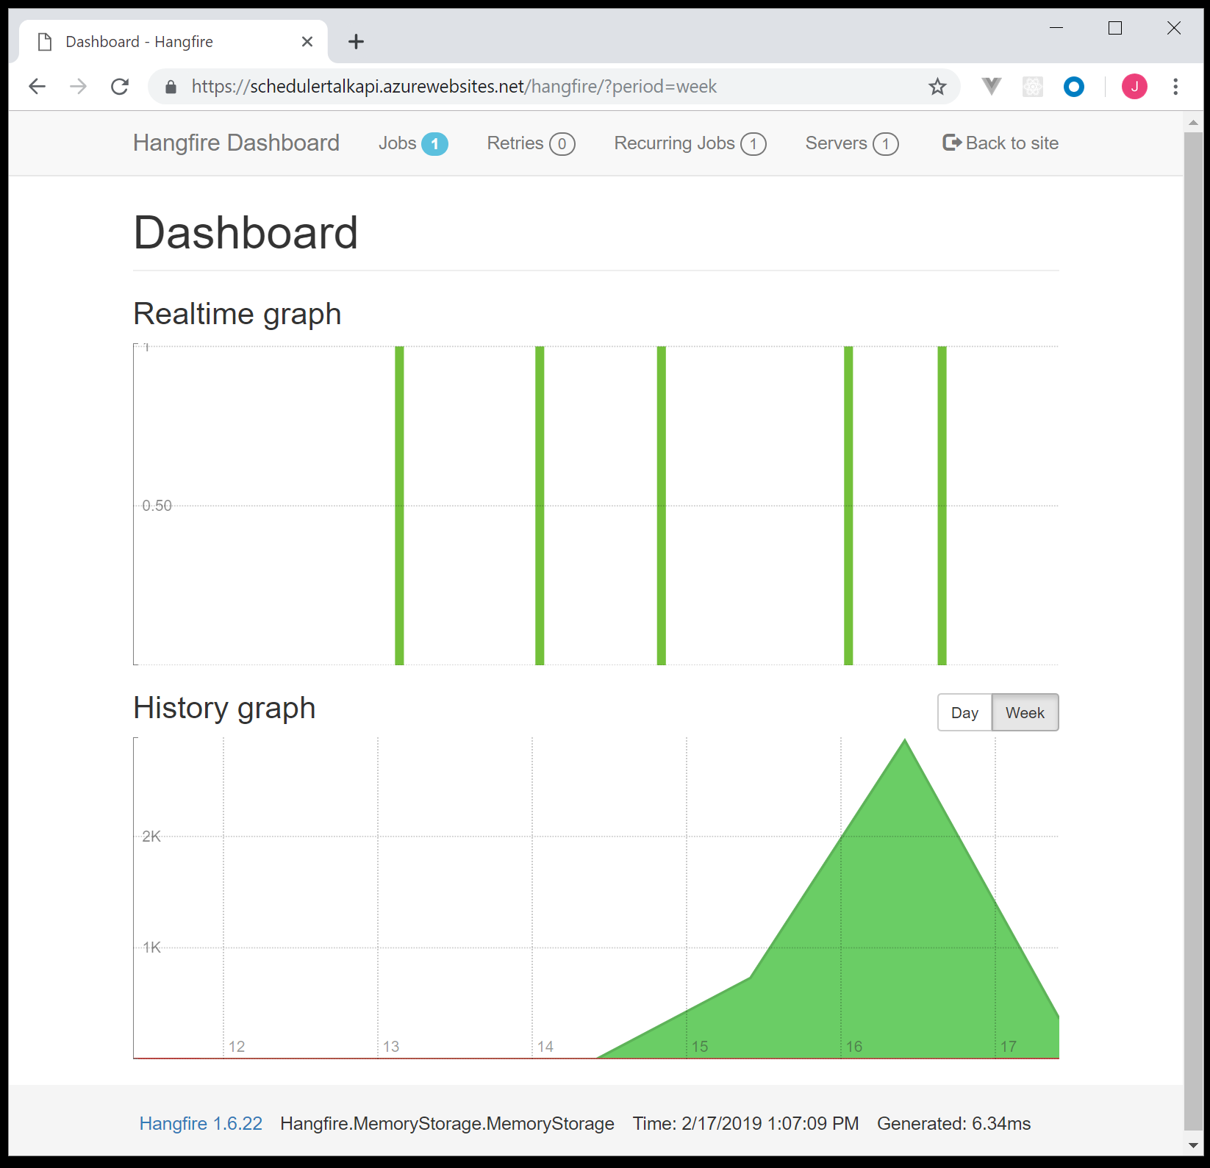
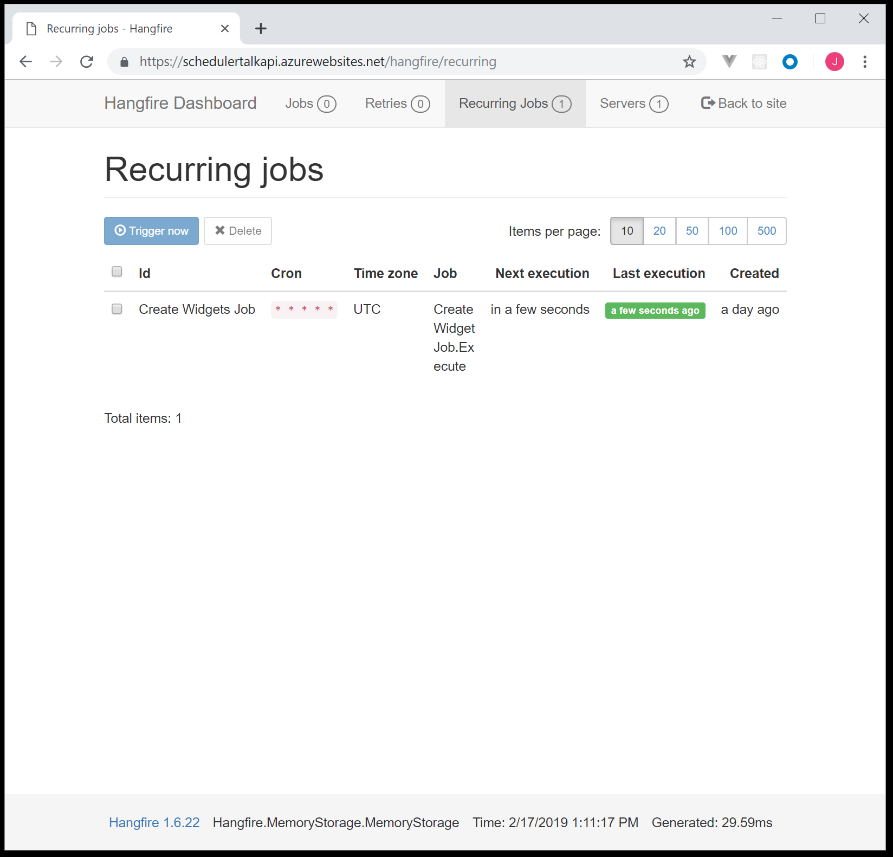
Hangfire Dashboard
Notes:
Graphs
Recurring Jobs -> Meat

Slide 10
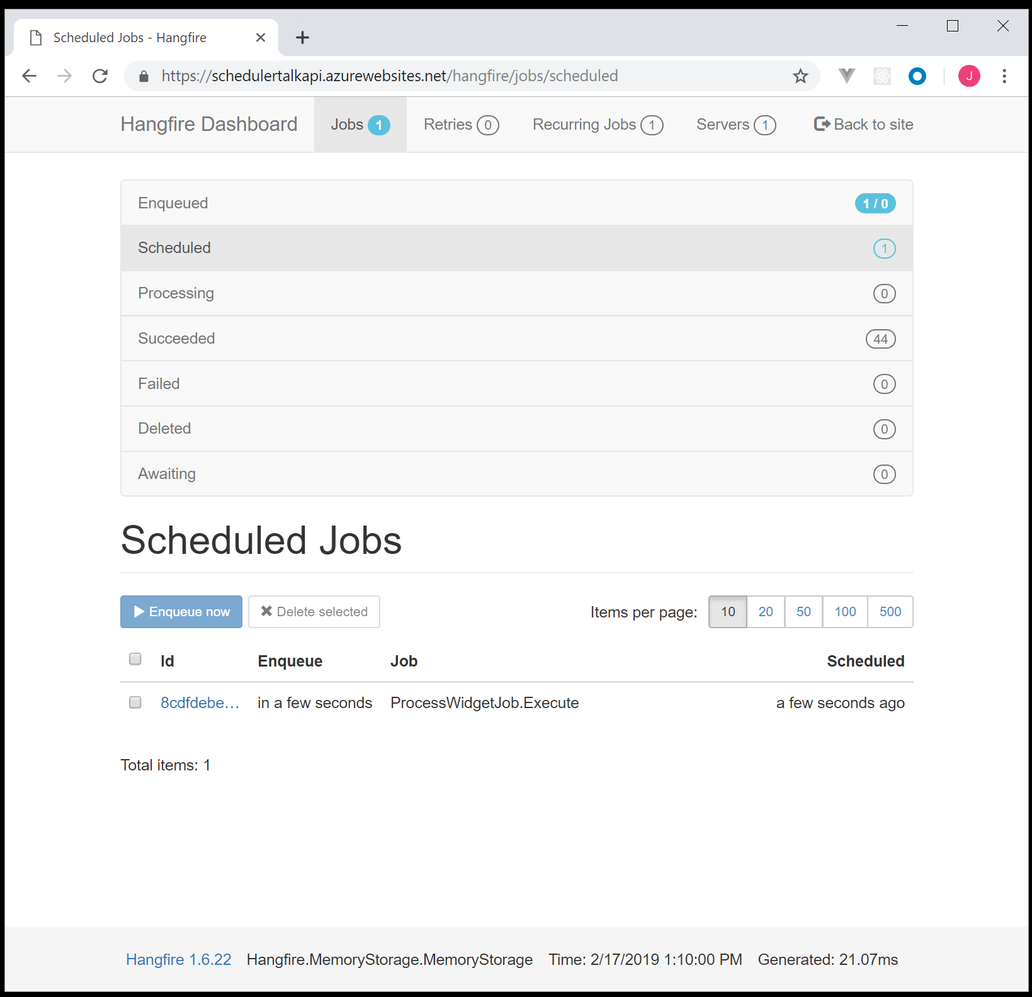
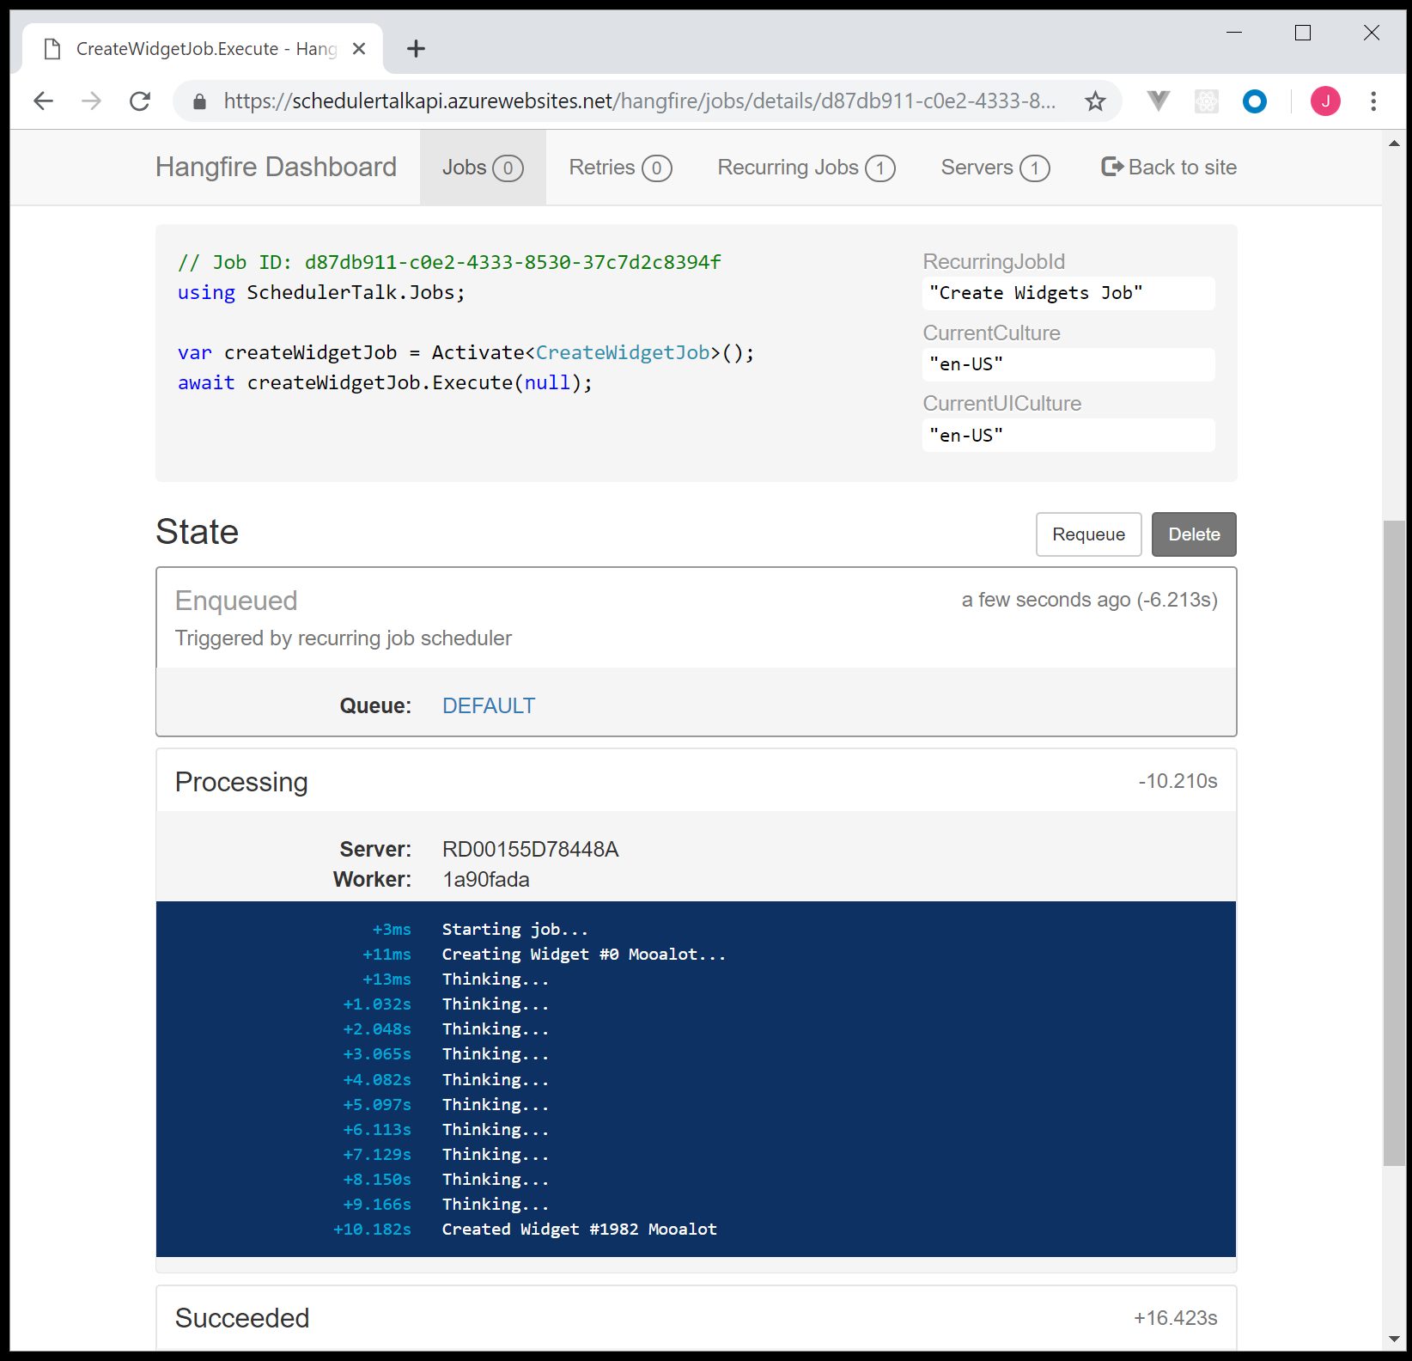
Hangfire Dashboard II
Notes:
Enqueued
Scheduled
Processing
ECT… The Job Lifecycle.
Job Details

Slide 11
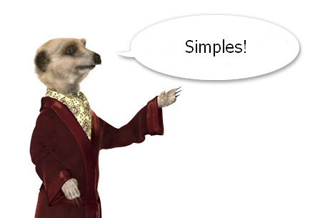
Notes:
Simples
Skipped Exception Handling and Security…
Follow Nose.
GitHub Example

Slide 12



Notes:
Fight Night
So we have seen who is in the left corner. In the right corer, is Azure Logic Apss, Weighing in at 97 billion USD… But its all going to charity.

Slide 13

“In 2016, we launched Azure Logic Apps, which includes the ability to configure and run scheduled jobs as well as advanced workflow features other stuff.”
Microsoft Flow
Workflow engine
200+ Connectors (Integration)
Notes:
“In 2016, we launched Azure Logic Apps, which includes the ability to configure and run scheduled jobs as well as advanced workflow features.”
Base off Flow. Name?! Marketing Department.
Workflow engine 200+ Connectors
Task -> Email -> Log Jira Bug… COOL
Microsoft Flow (I feel the need to apologies for the name). It’s apart of their Microsoft 365 sweet. Marketing department. Workflow engine. 200+ Connectors. Run a task, if it falls over, send an email, log a Jira bug etc… The possibilities are actually pretty amazing. Its all in a drag and drop interface your managers can… Well they can bug you to help make them work as if you were using a real programming language.

Slide 14
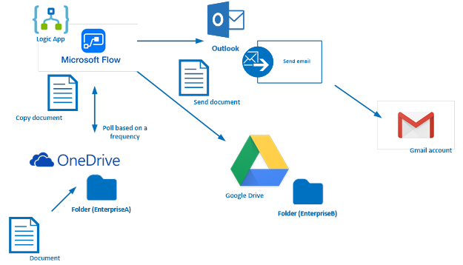
Azure Logic Apps
Notes:
"Automate many of the workflows you have in place, without writing a single line of code“
You could: Upload a document to one drive. Copy it to Google Drive in a folder. Send an email using outlook to someone on Gmail…. It’s CRAZY

Slide 15

Microsoft Marketing 301
Notes:
* Video
Its so crazy I just cant begin to explain it, so instead Im going to make you watch this video. Thoughts? My thoughs are I couldn’t give a rats arse. My boss is wriggling in his chair in excitement, and I hope he never reads this presentation.

Slide 16
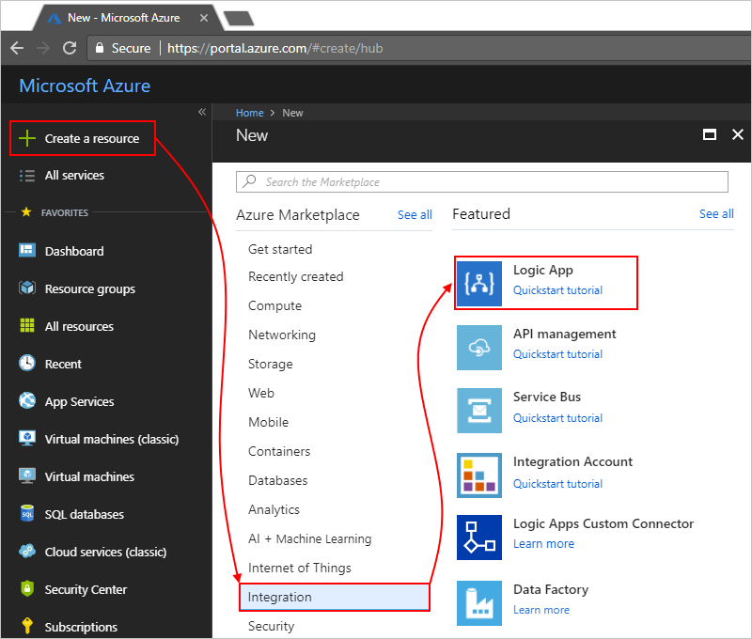
Creating a Logic App
Notes:
No Internet Connection
So Login to Azure. Walkthrough
I don’t have an internet connection in this device so it’s all screen captures. Some of the screen captures aren’t even mine. So Login to Azure. Create Resource -> Integration -> Logic App

Slide 17
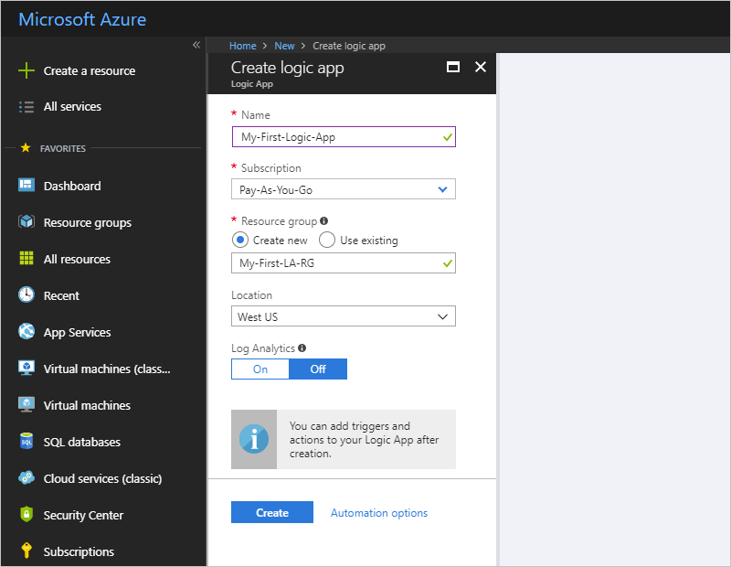
Creating a Logic App II
Notes:
Standard UI: This is a pretty standard interface for creating an Azure widget.
* Gold Coast Azure / .Net Users Group Being this the Gold Coast Azure / .Net Users Group…. Work it out yourself.

Slide 18
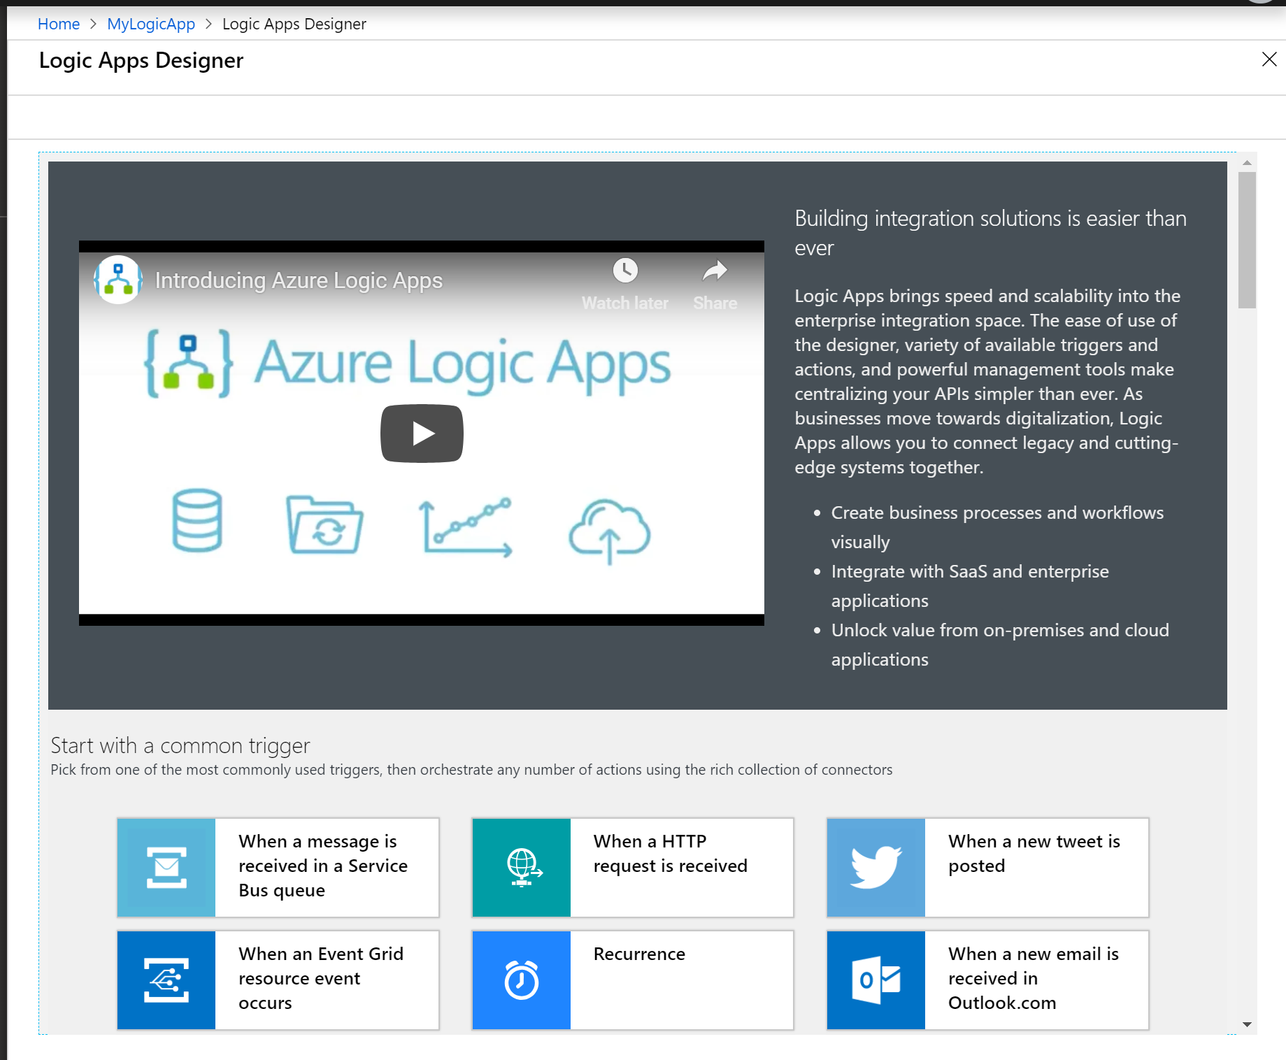

Create a Scheduled Job….
Notes:
Recurence // Odd // Alarm Clock. It’s called a Recurence… Sure the alarm clock helps.

Slide 19
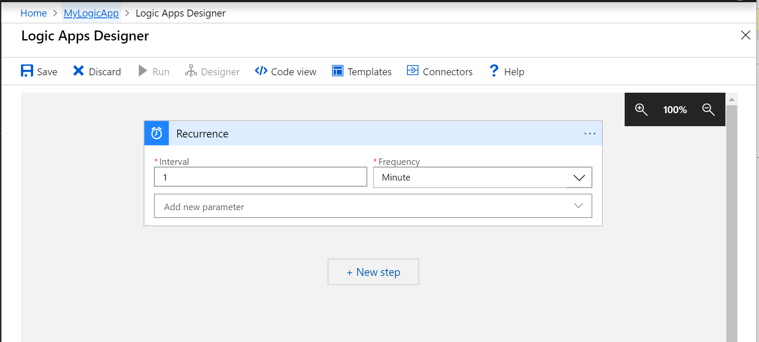



Workflow Designer
Notes:
Crazy Resoltion
1 Minute
Next Step
Im not sure what resolution they are expecting every one to have. Im sure my boss has a 4k Monitor, he will use it fine. Interval… 1 MINUTE! What was Azure Scheduler? 1 hour before you pay for it? Your paying for this, but its cheep. 1 minute Interval is approximately $0.10c a day. Set your Interval. Set your Frequency. Next Step

Slide 20
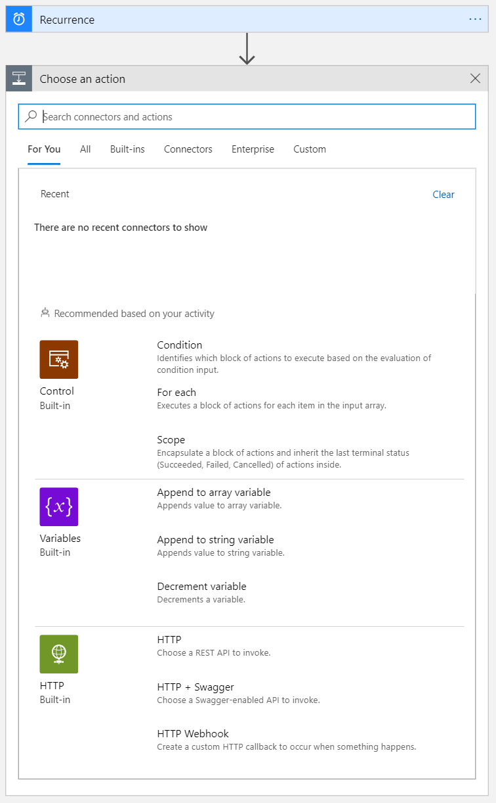
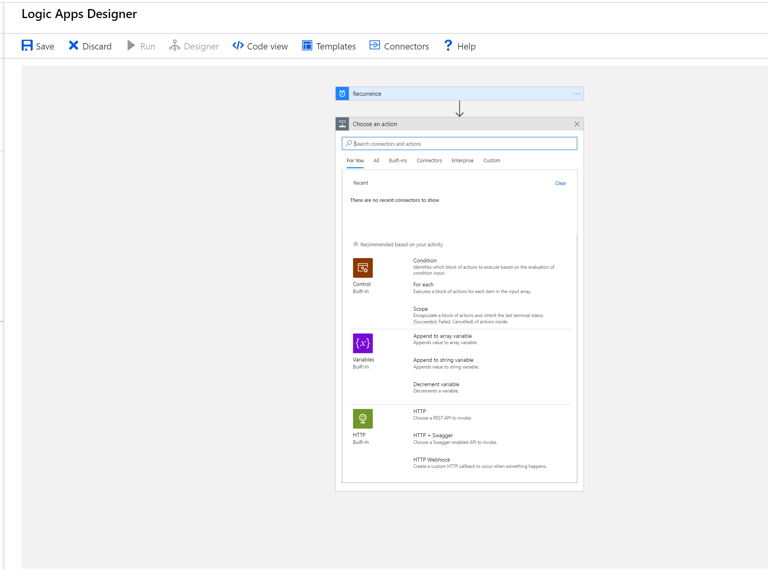
Select an Action
Notes:
Lots You Can Do. Obviously lots of stuff you can do here.
Conditionals
Loops
Variables
Connectors (Integration)
* Gold Coast Azure / .Net Users Group. Being this the Gold Coast Azure / .Net Users Group…. I’m sure you know what all that means.

Slide 21
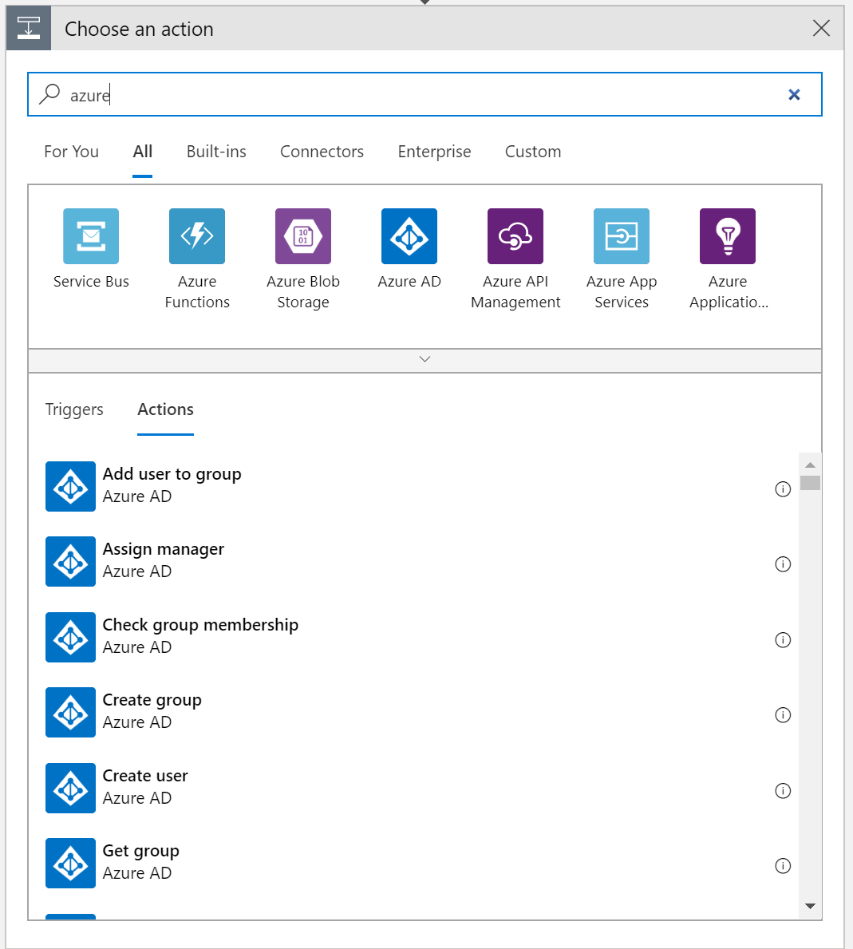
Select an Action II – Azure Jobs/Functions?
Notes:
Azure Functions… Out of interest it does have Azure Functions, I didn’t see Jobs but I am sure they are there.
Limitations / Benefits

Slide 22
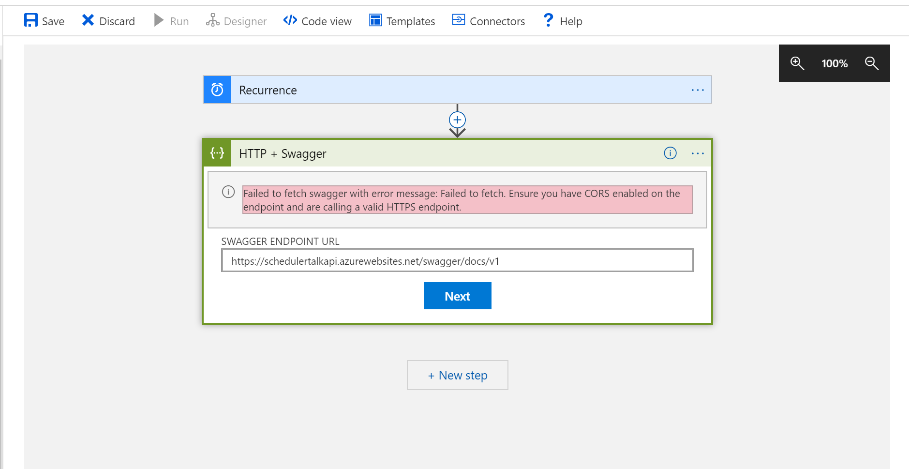
Select an Action III = SWAGGER!
Notes:
OMG Swagger! It has swagger, I am such a fan!
OMG Cors… I don’t have time for that.

Slide 23
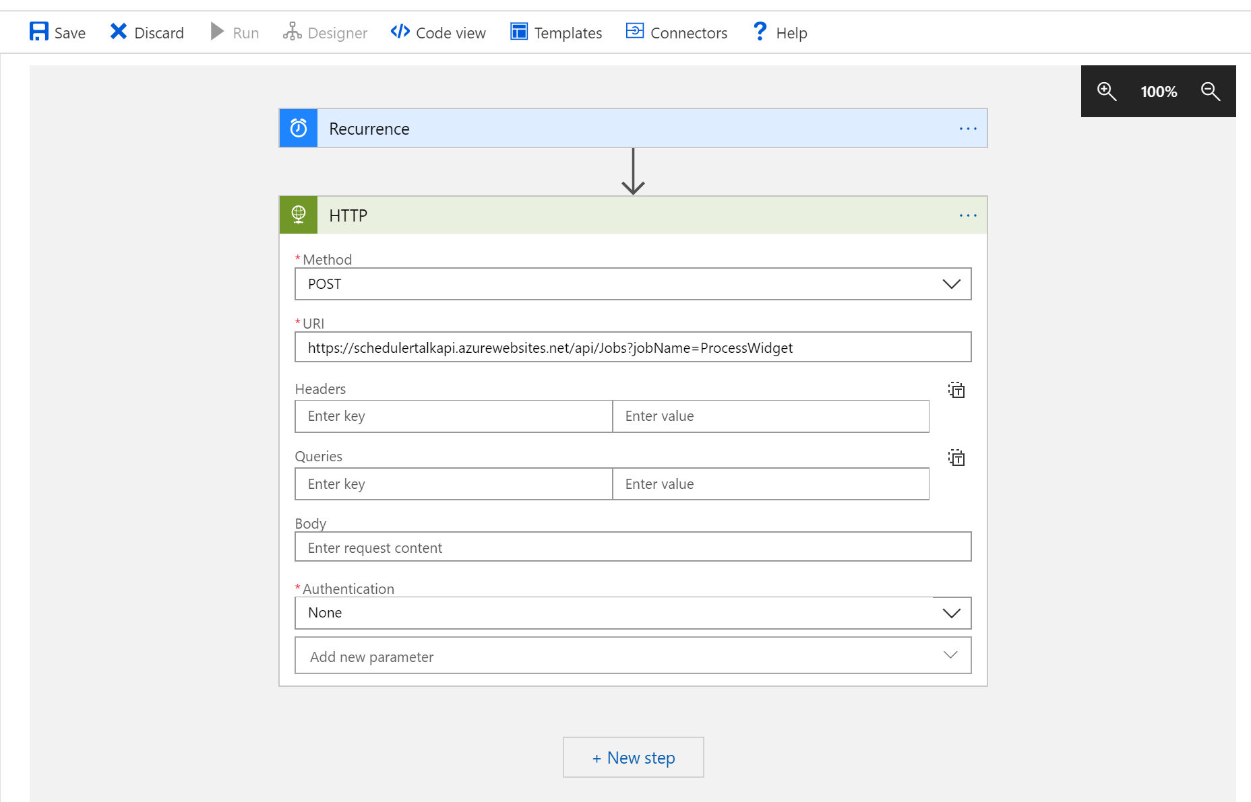

Select an Action = HTTP End Point
Notes:
HTTP End Point…. I know I know but the food is almost ready.
Food Almost Ready

Slide 24
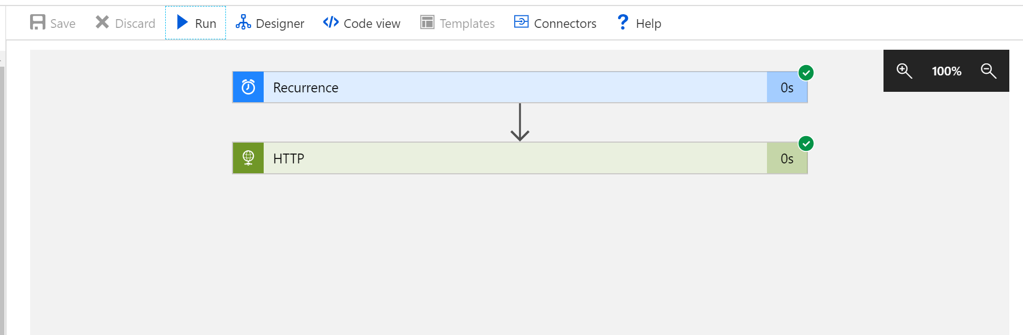

Run a Job
Notes:
Hit Run
Uninspiring Response.. And you get this, really uninspiring response.
That’s not very exciting.

Slide 25
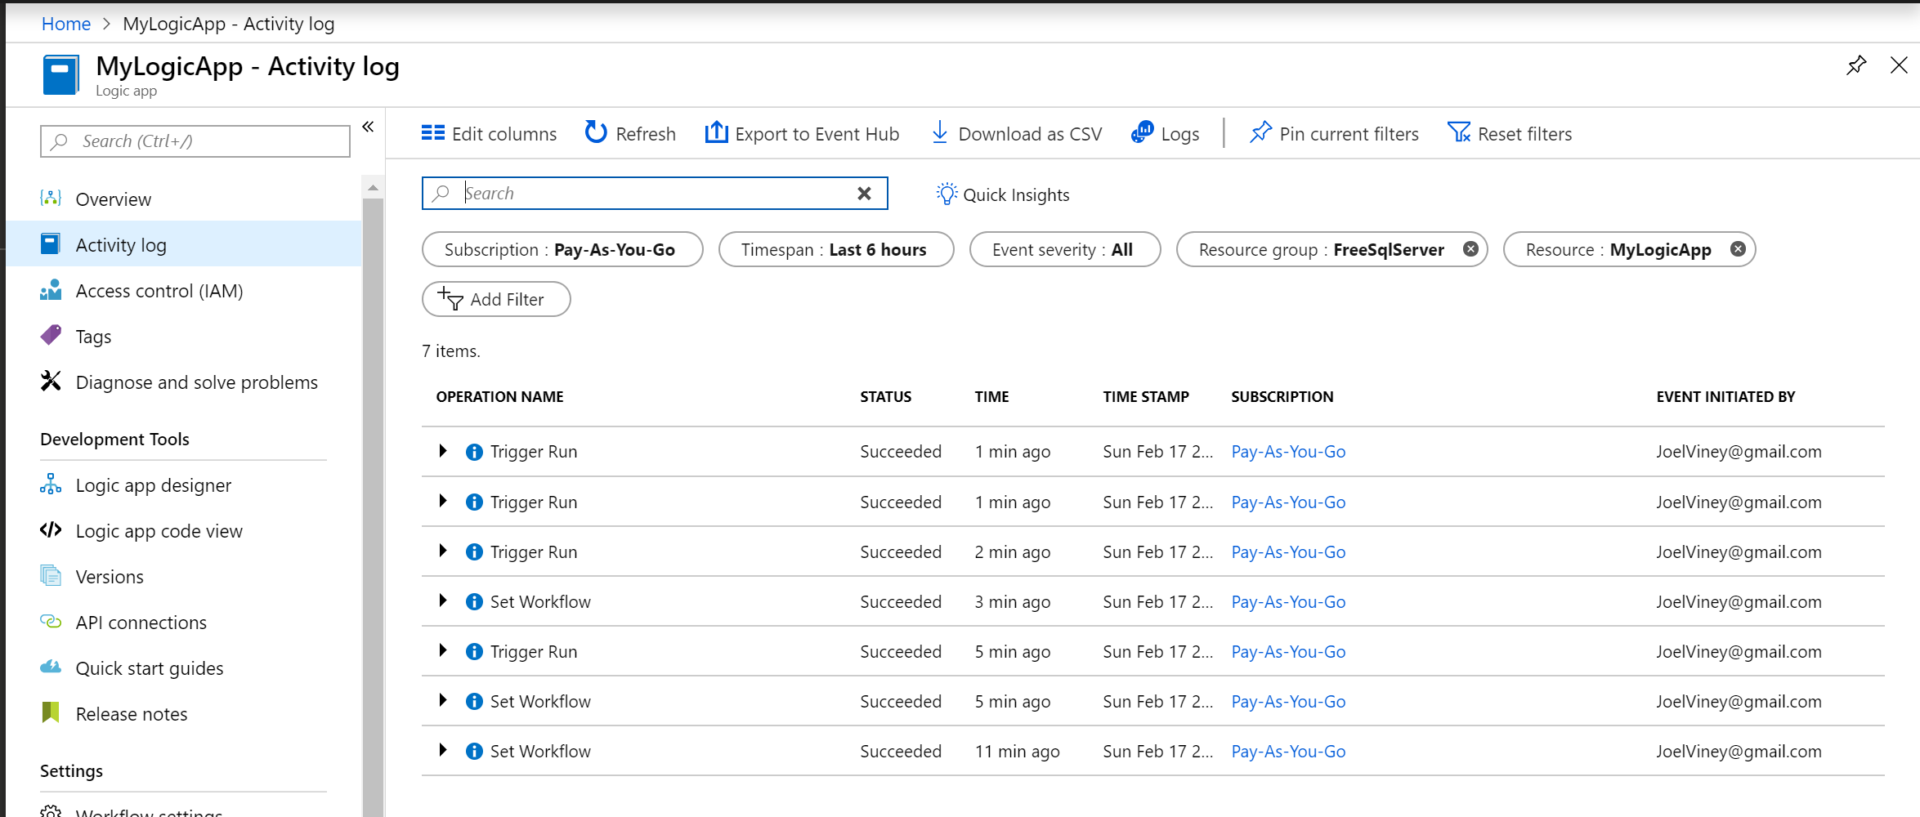
View the Activity Log
Notes:
Logs? Okay. Here you can see the activity log of your calls.

Slide 26

Azure Logic Apps… Okay?
Azure Scheduler was simple.
Azure Logic Apps Baggage
Land Grab by Microsoft?
Notes:
* Okay, so where does this leave us?
* Scheduler was simple. Will it be missed?
Logic Apps not Complex, but Baggage.
Land Grab. Western Times, Wagons ETC…
This wasn’t really complex. But it comes with a lot of baggage. As developers do we really care? Or will we get sucked in by the ability to log Jira calls when a Job fails?
This seems like a bit of a land grab by Microsoft, but at the wrong target. I don’t know.
There are some cool features in there. It might save you having to write a dodgy integration.

Slide 27
Summary
Some of the historic options for scheduling
Hangfire
What is it
How to Install it
How to use it
Pretty Dashboard
Azure Logic Apps
OMG what is it
How to use it
How much does it cost me?
Do I need all that stuff?
Notes:
Verbatim

Slide 28
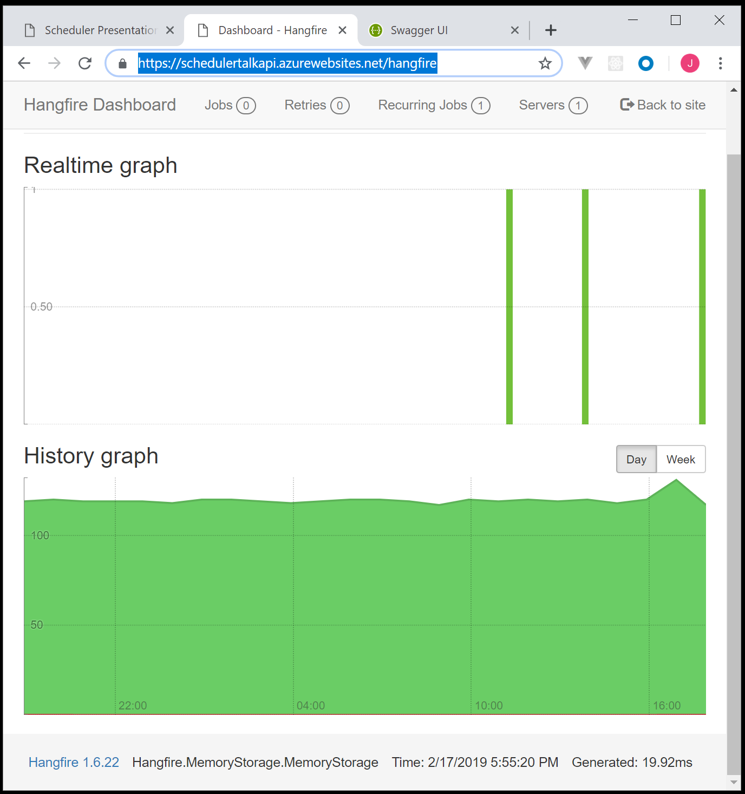
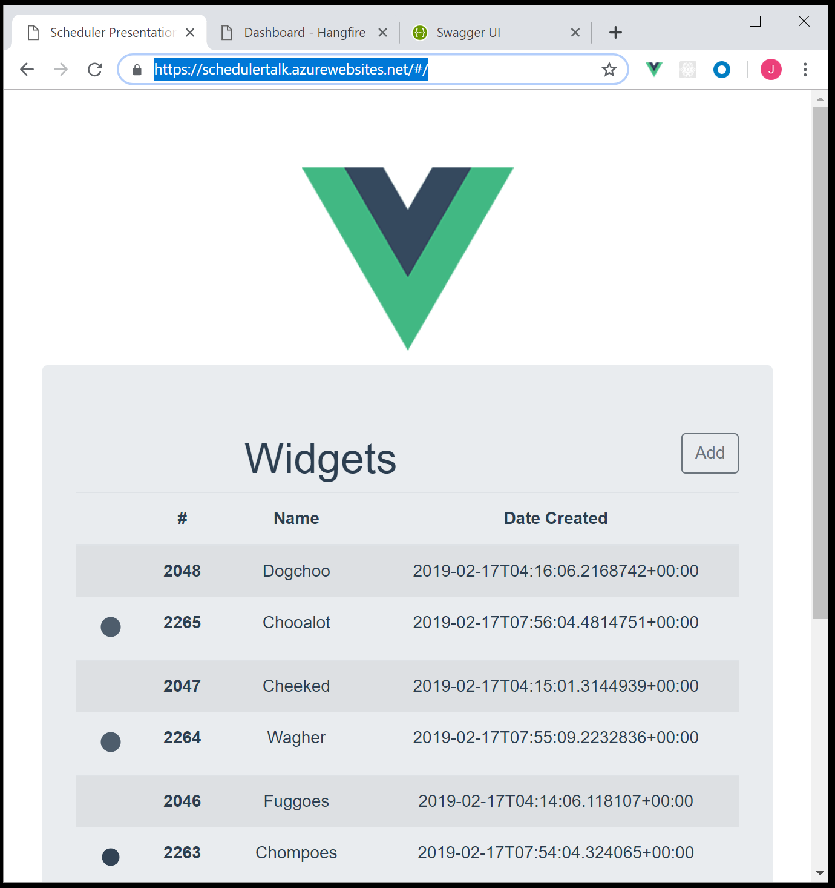
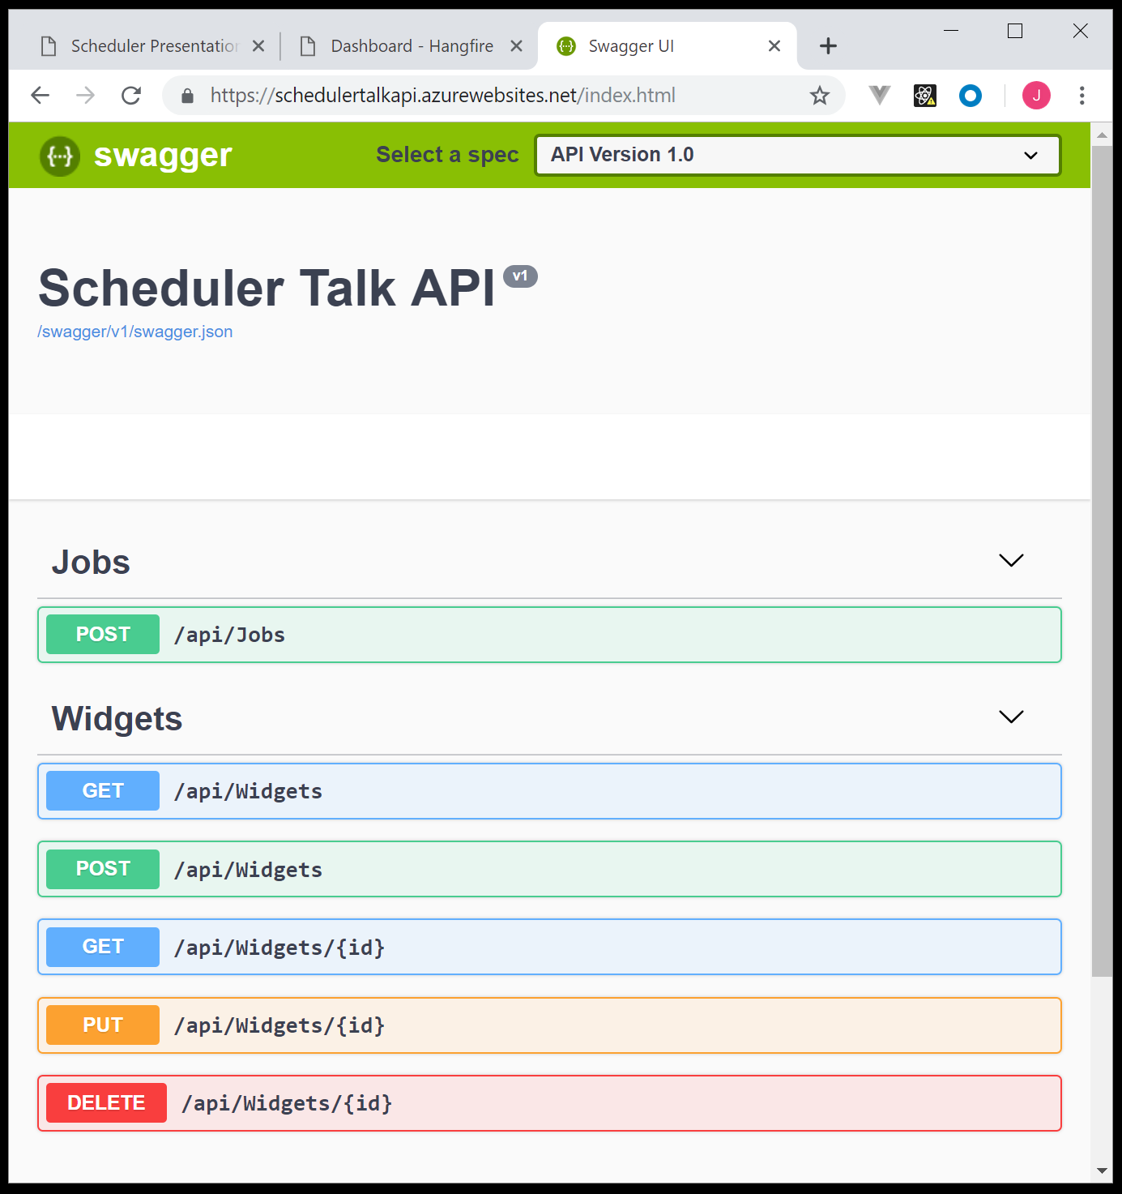
Github Example
Net Core API, Hangfire, Azure, Vue, SignalR, Nlog
https://github.com/JoelViney/SchedulerTalk
https://schedulertalk.azurewebsites.net/
https://schedulertalkapi.azurewebsites.net/hangfire
Notes:
Github -> .Net Core, Hangfire, Vue, SignalR and Nlog.
So if anyone is interested I have a Github example up using Hangfire, Vue, SignalR and Nlog.
As well as this presentation.

Slide 29
Thank you
Hangfire and Hangfire.Console
https://www.hangfire.io/
https://github.com/pieceofsummer/Hangfire.Console
Azure Logic Apps
https://azure.microsoft.com/en-au/services/logic-apps/
Notes:
Thank you.

